Slide 1
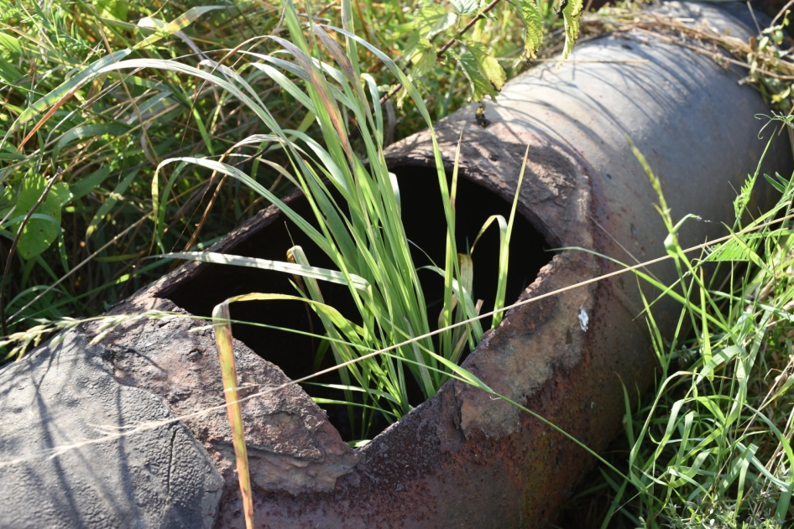
Activities of the local group from Hrádek nad Nisou
Šárka Soukupová, 13. 11. 2018

Slide 2
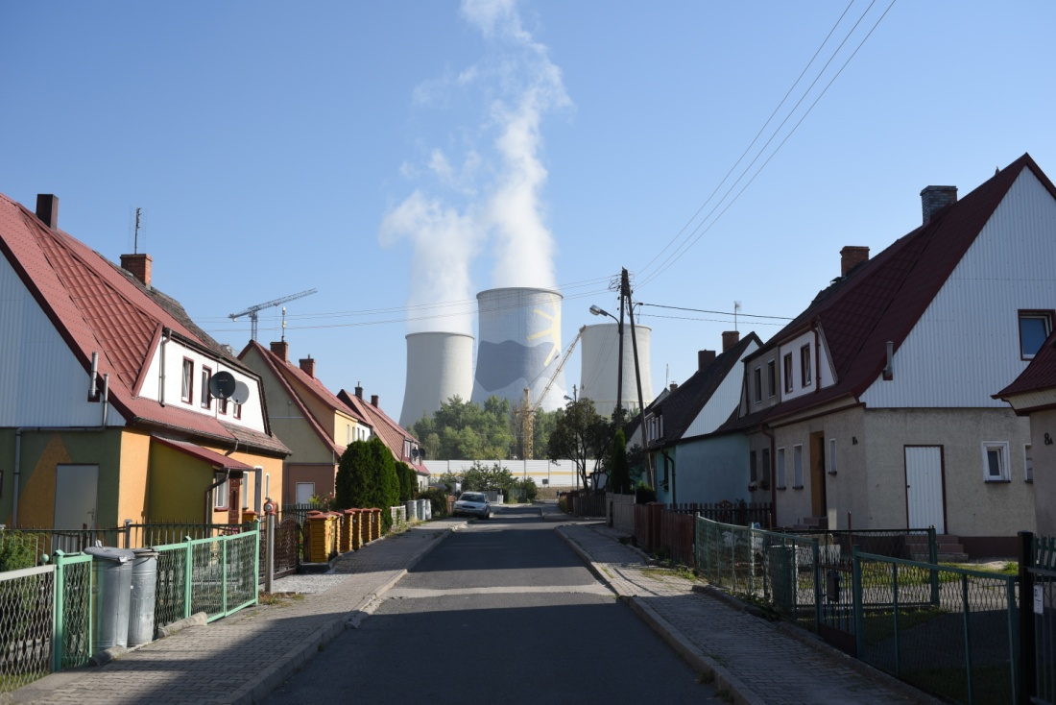
Content
Introduction
Events
Media
Politicians
Drought
Future?

Slide 3
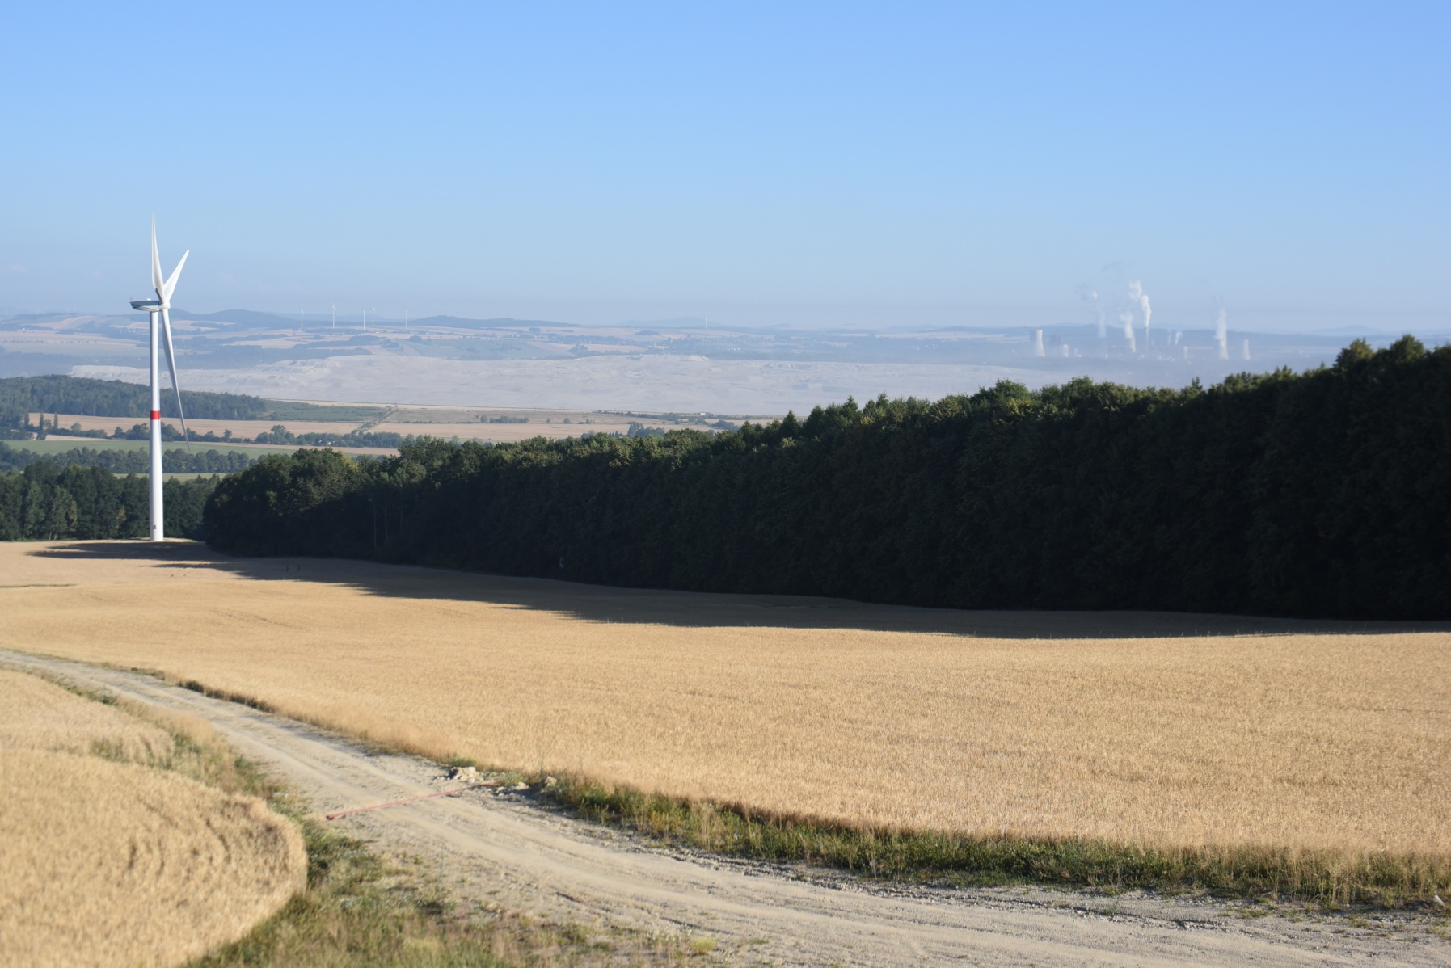
Introduction

Slide 4
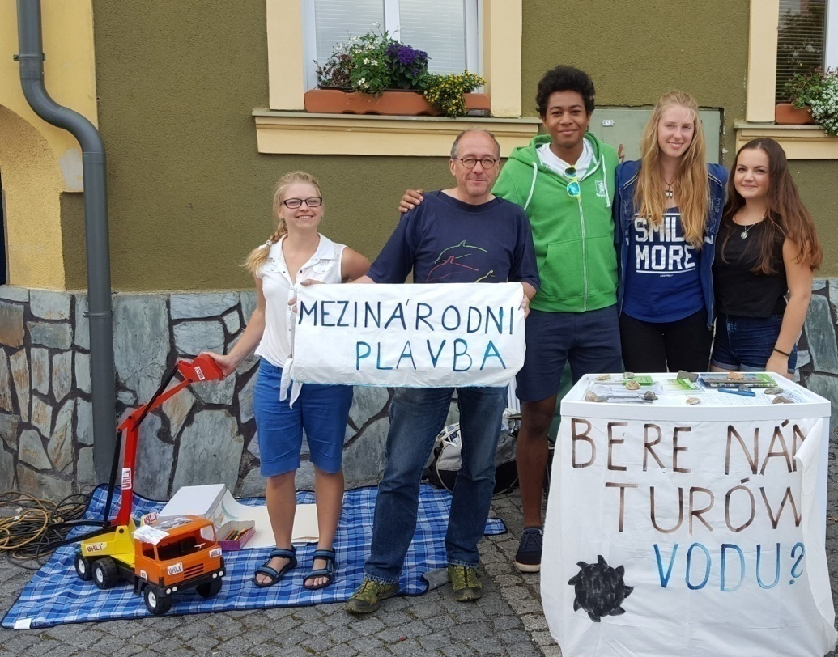
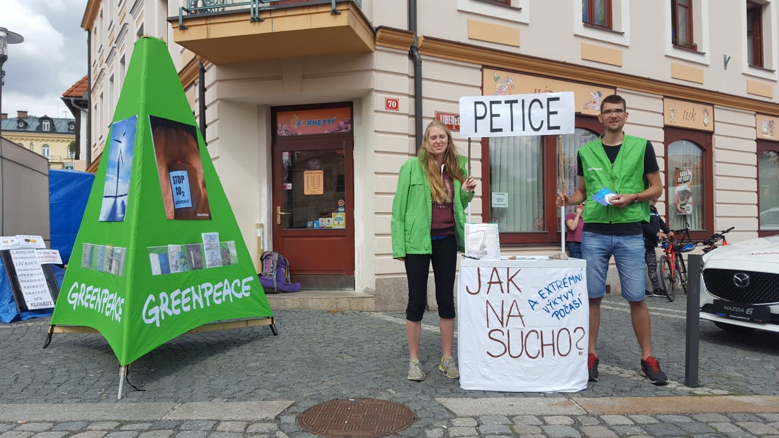
Hrádecké slavnosti a Bartolomějská pouť (festival)

Slide 5
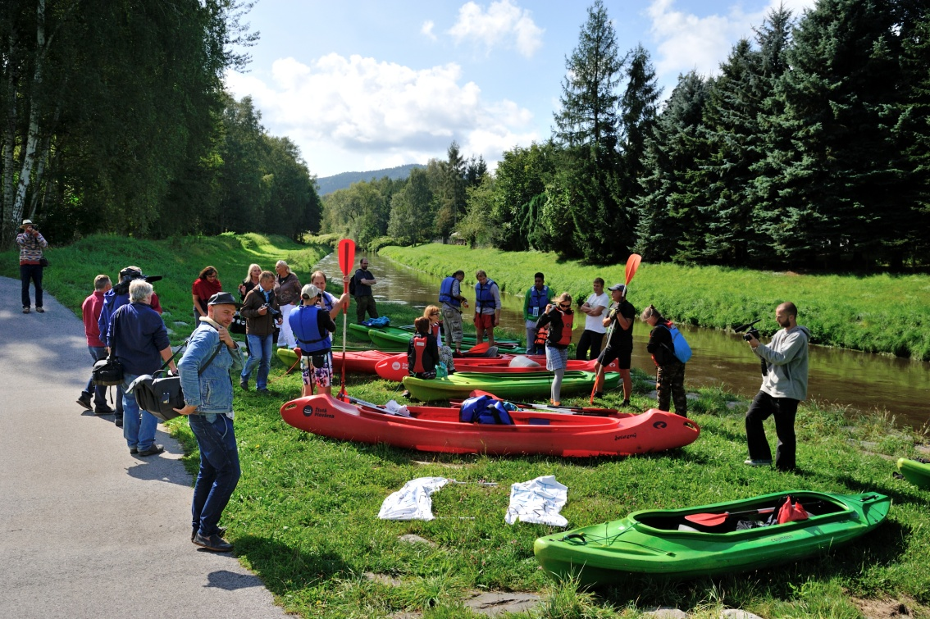
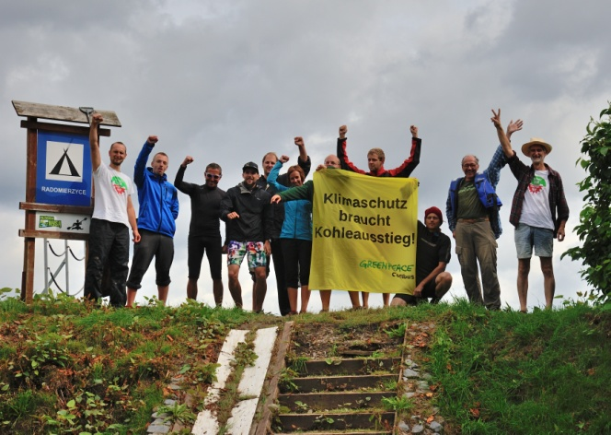
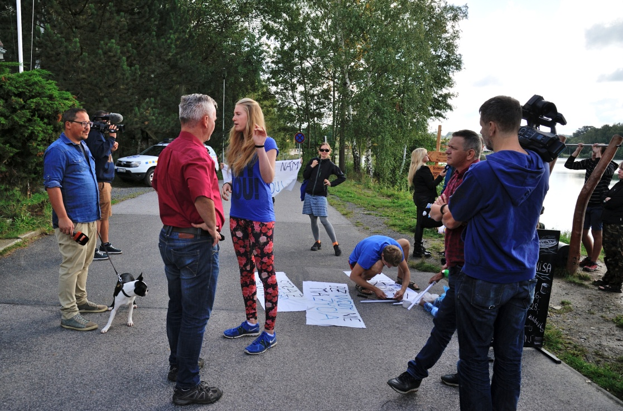
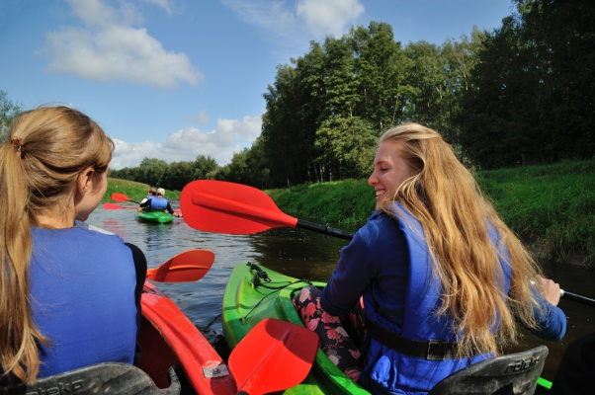
Kayaking

Slide 6
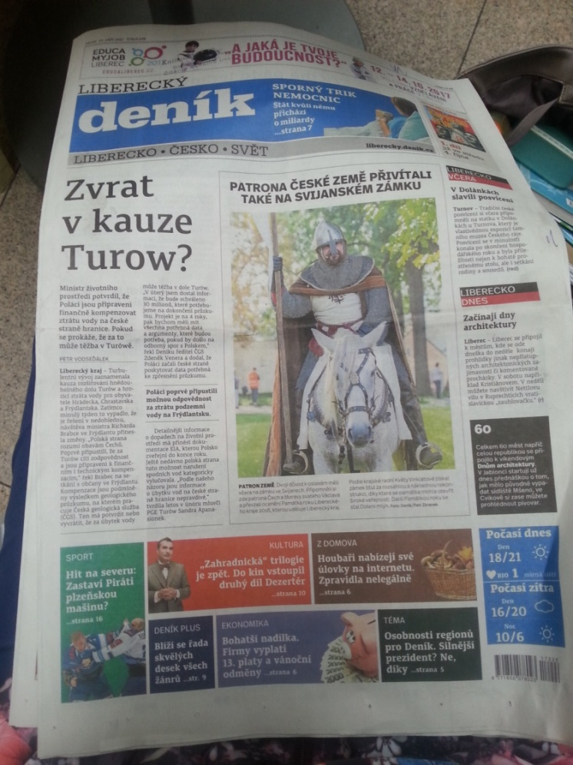
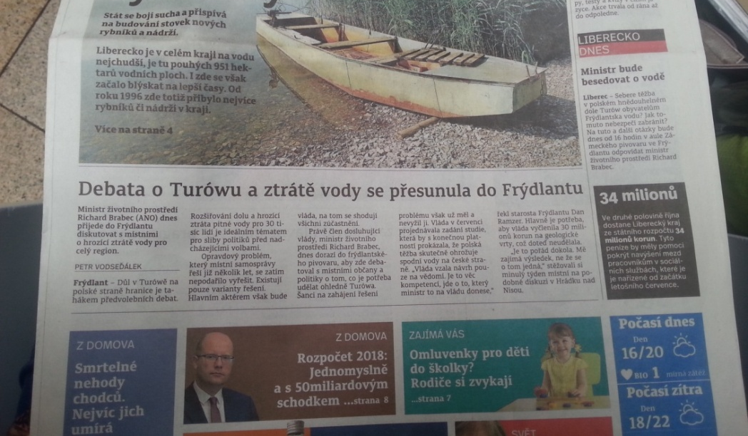
Media

Slide 7
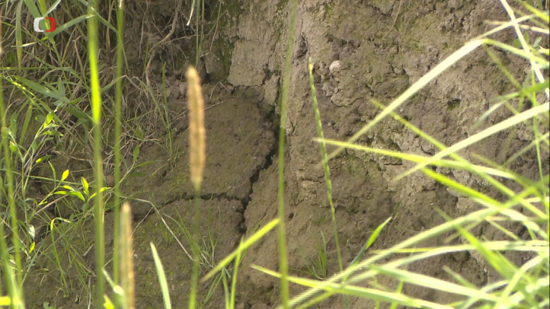
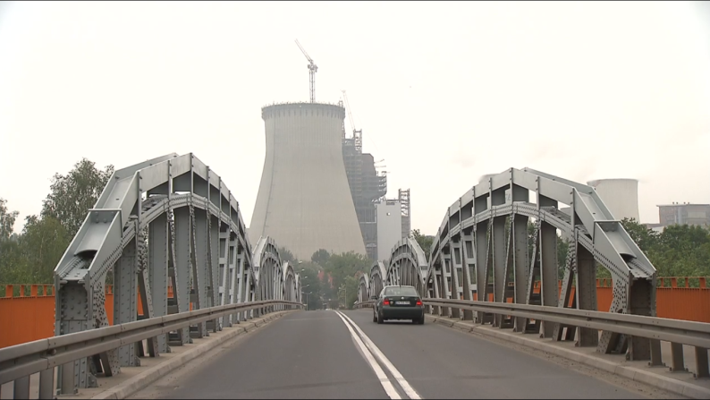
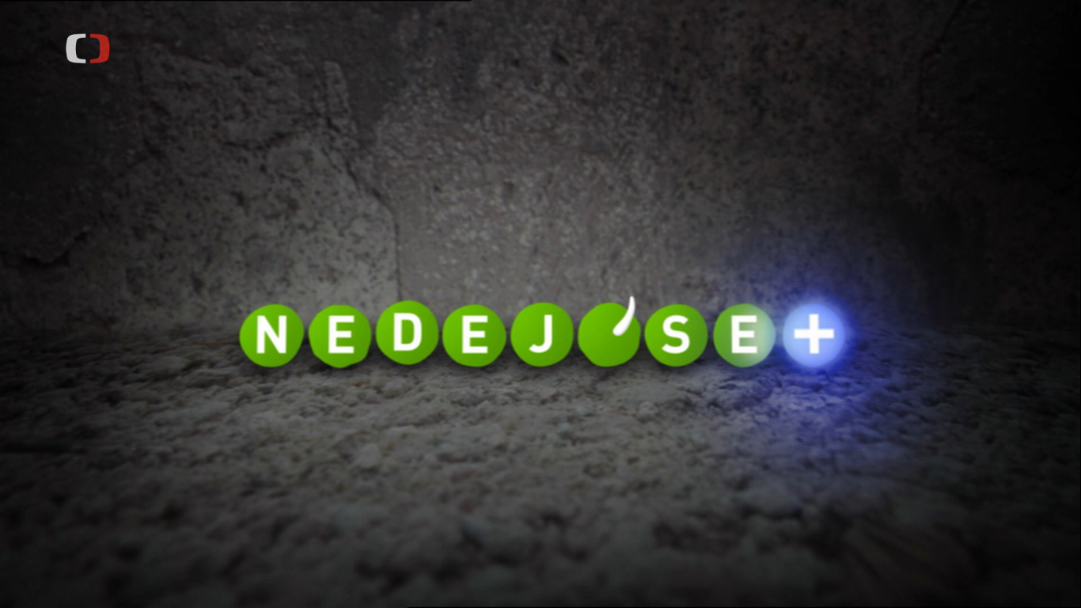
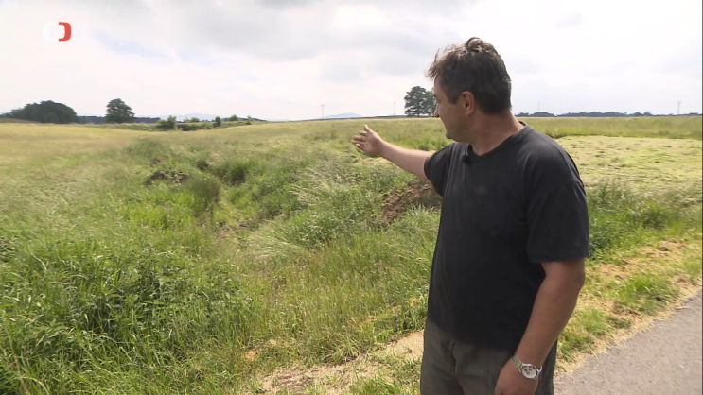
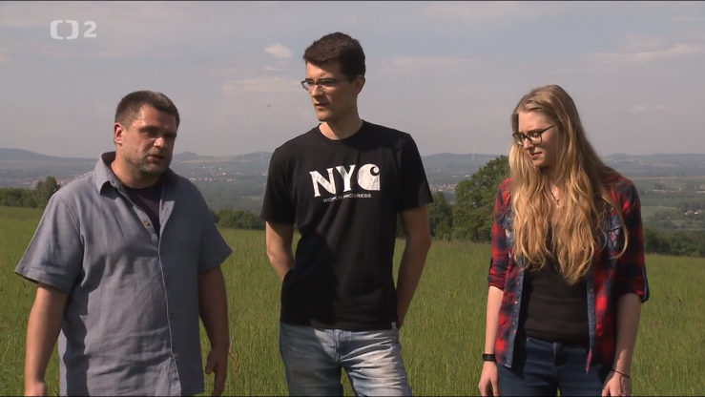
Two documentary movies

Slide 8
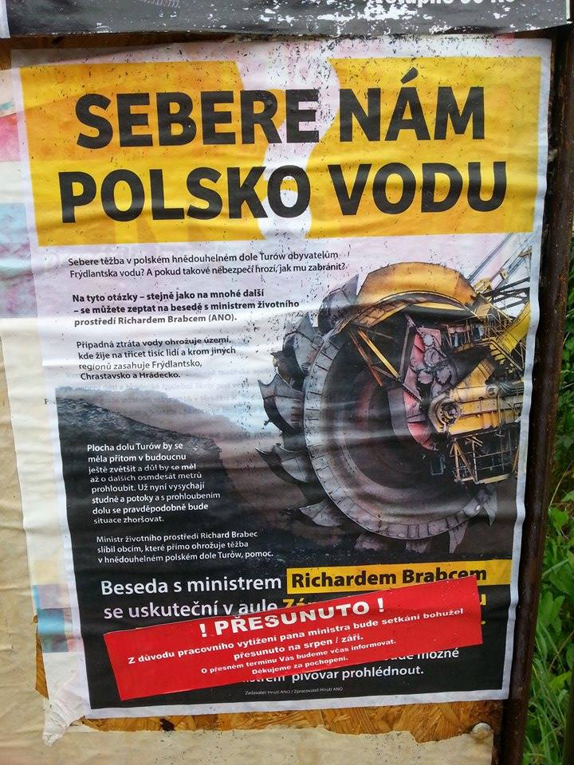
Politicians

Slide 9
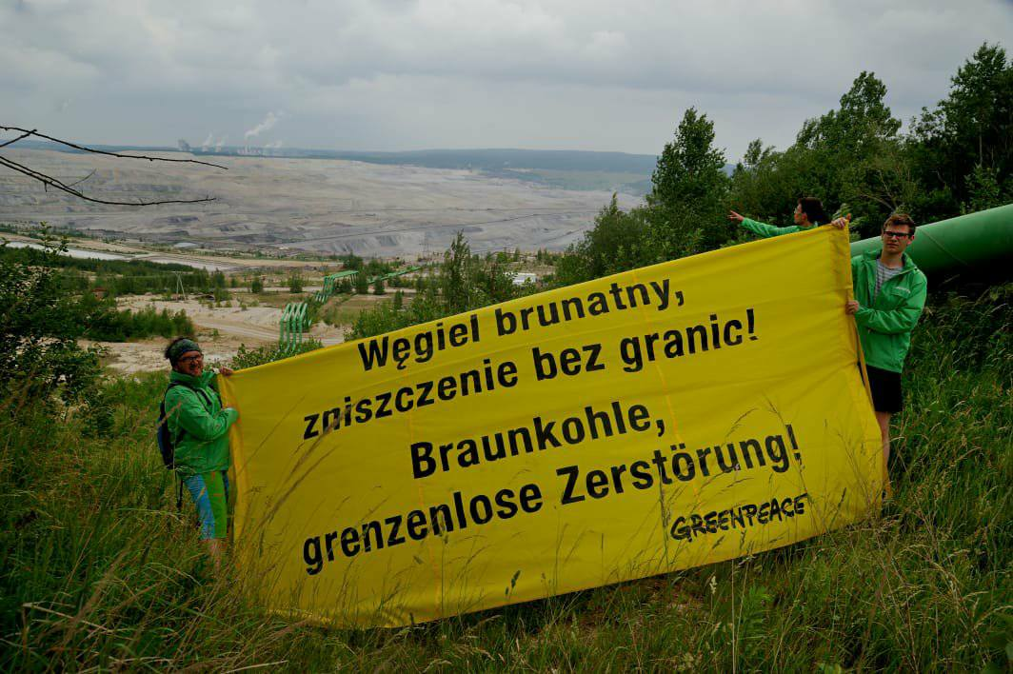
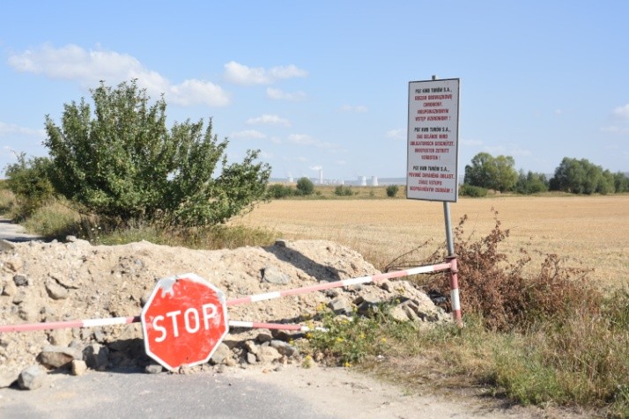
Interests of other groups and people

Slide 10
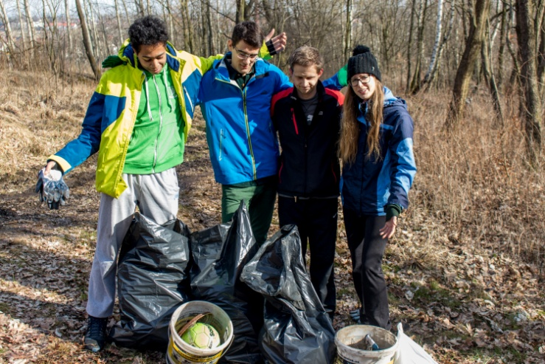
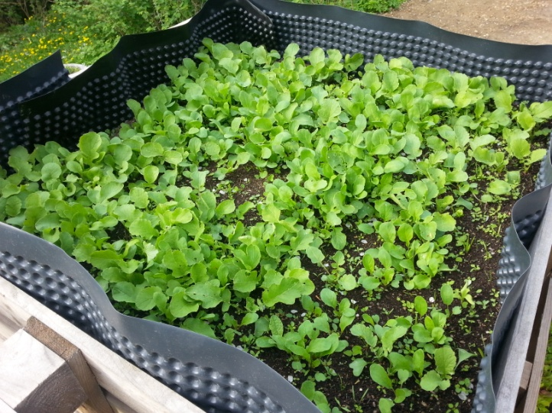
EKOvýzva

Slide 11
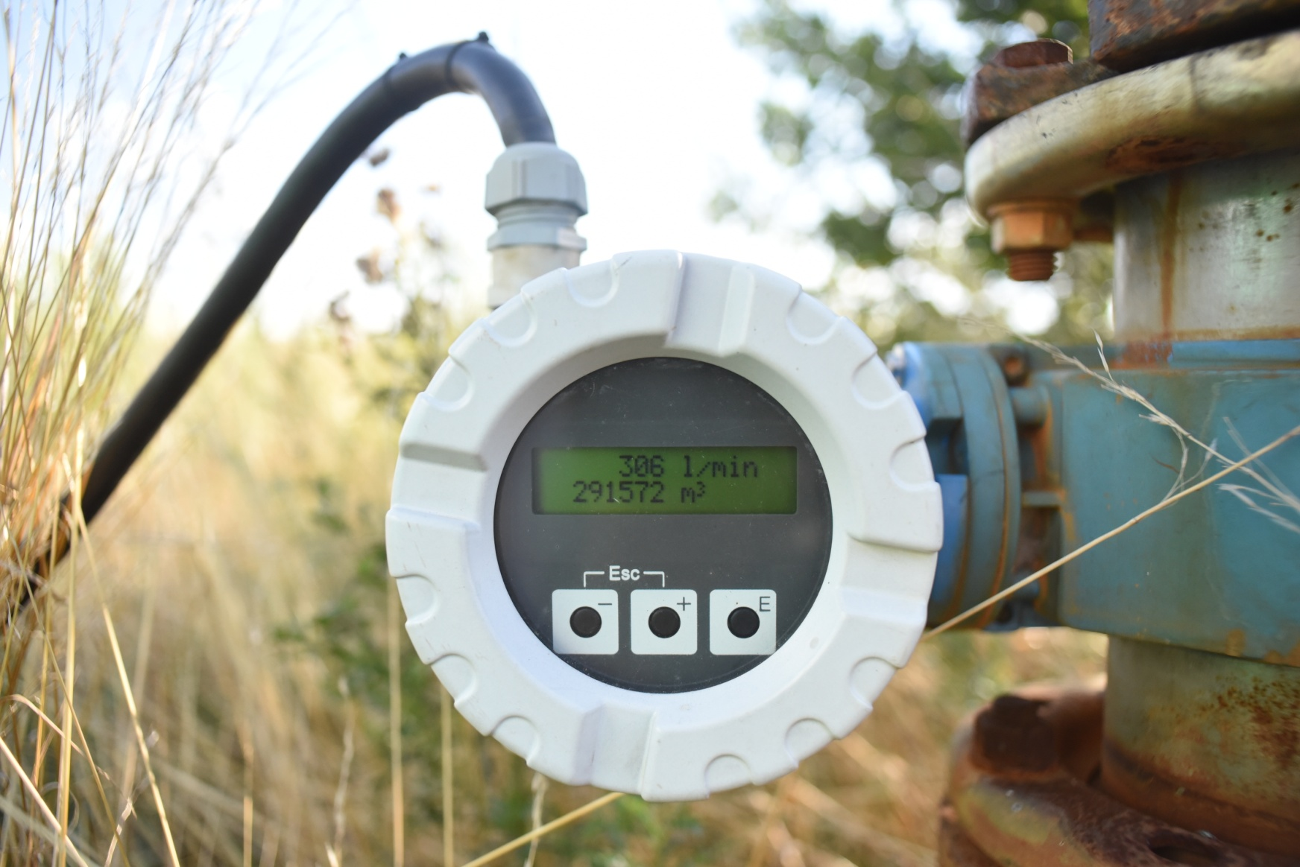
Climate change and drought

Slide 12
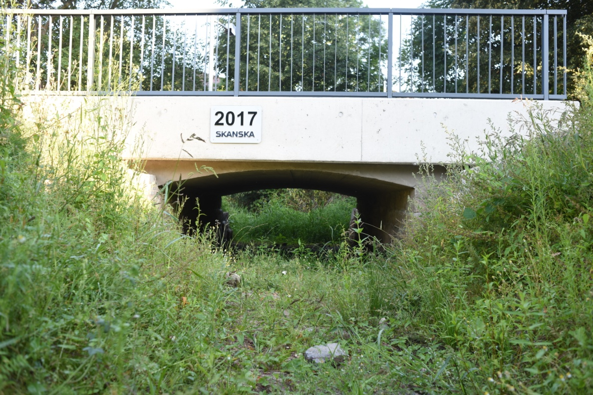
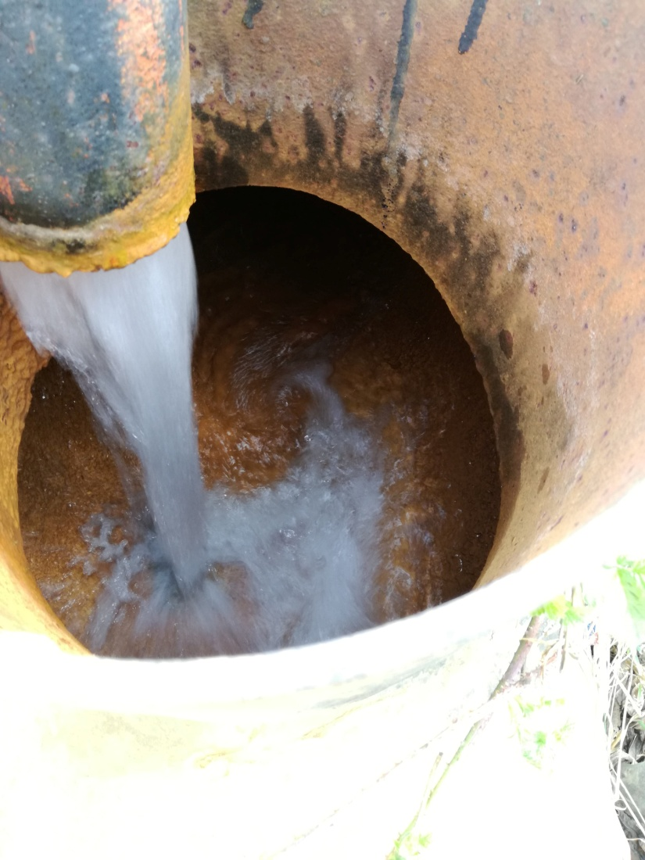
Climate change and drought

Slide 13
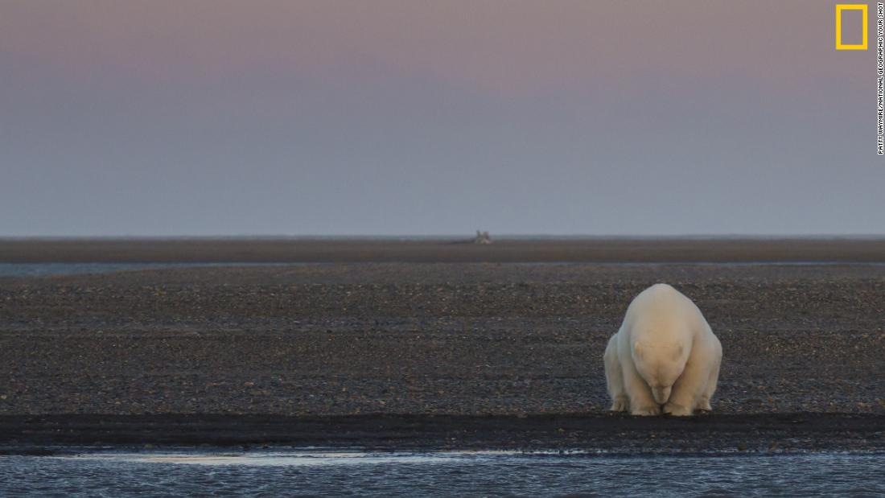
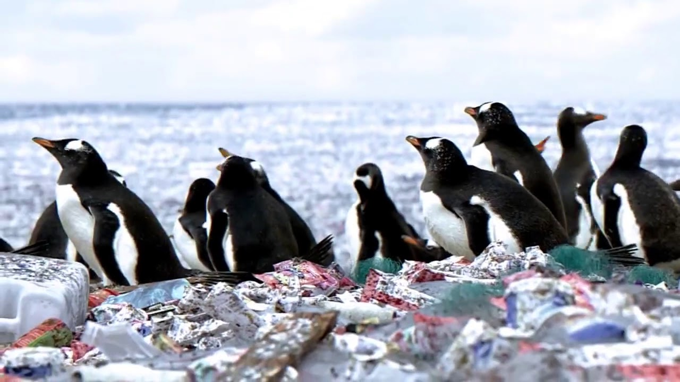
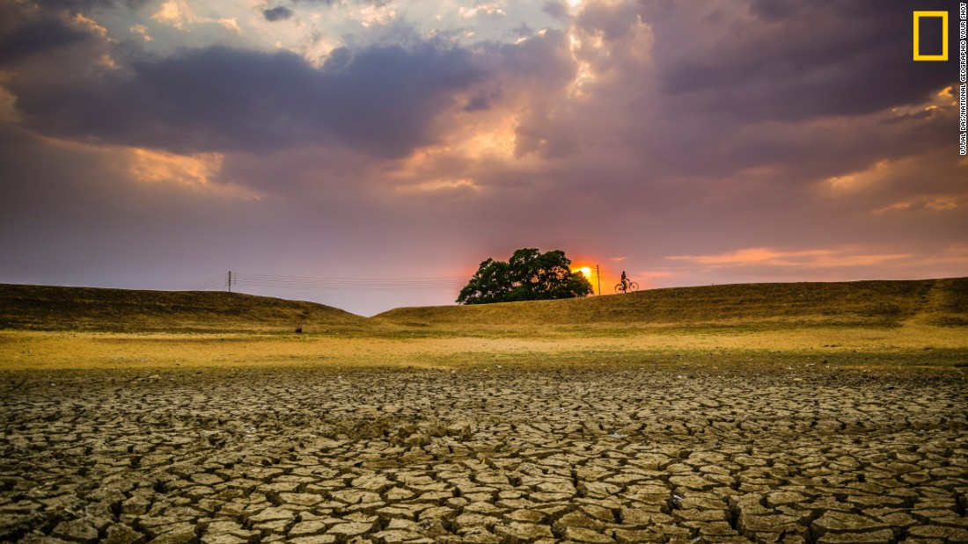
Future of our planet?

Slide 14
Thank you for your attention!

Slide 15
Sources
https://www.ekovyzva.cz/
https://www.sz-online.de/
https://limityjsmemy.cz/
https://www.internazionale.it/reportage/marina-forti/2018/04/16/carbone-polonia-generali-italia
https://liberecky.denik.cz/zpravy_region/polaci-pripustili-moznou-zodpovednost-za-ztratu-vody-20170928.html
https://liberecky.denik.cz/zpravy_region/debata-o-turowu-a-ztrate-vody-se-presunula-do-frydlantu-20170926.html
https://www.ceskatelevize.cz/ivysilani/10782831463-nedej-se-plus/218562248410019
https://www.ceskatelevize.cz/porady/10782831463-nedej-se-plus/216562248410023-polske-uhli-ceska-voda-a-oteplovani-zeme/
Photos:
https://i.ytimg.com/vi/ouTY9vDHGWE/maxresdefault.jpg
https://edition.cnn.com/2016/11/16/world/gallery/cop22-photo-award/
http://benjaminlarderet.com/essays/

